Slide 1
Luxury Student Accommodation
The Quadrant, Liverpool, UK
www.pinnaclemcglobal.com

Slide 2
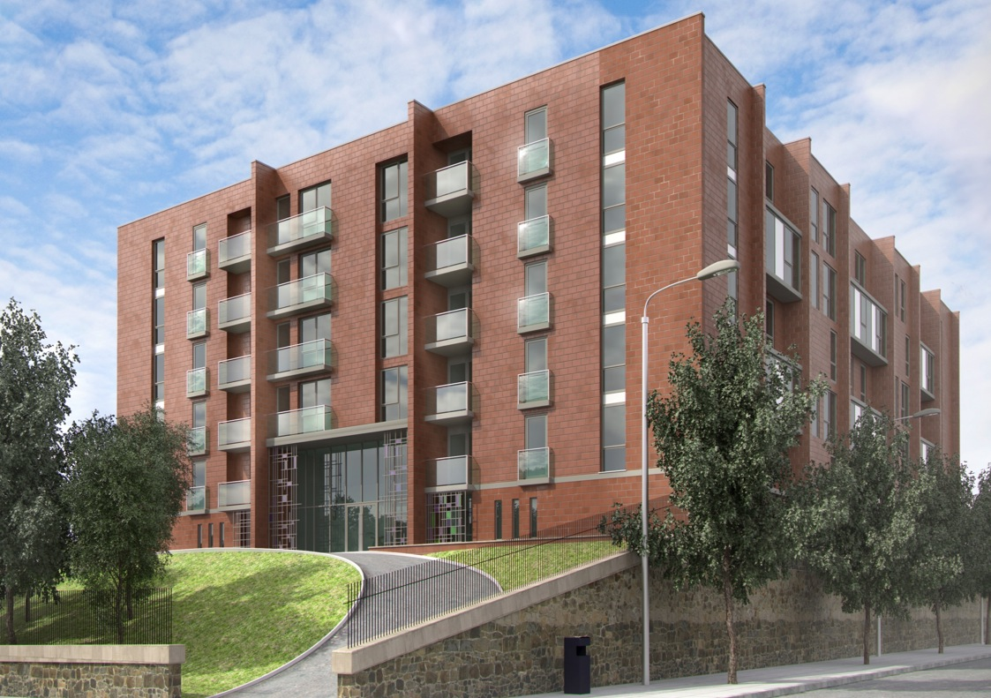

Slide 3
Introduction
Who are Pinnacle?
Why Invest in the UK?
Why Invest in Student Accommodation?
Why Invest in Liverpool?
The Quadrant
Previous Developments
Investment Figures

Slide 4
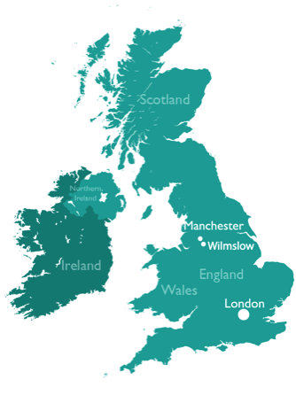
Meet The Team
Julie Harvey
Andrew Dixon
Nick Reagen
Suzi Saunders
Director
Director
Senior Business Development Manager
PA to the Board of Directors
Tim Woolven
Daniel Eccles
Mark Mansfield
Stacey Cockerill
Business Development Manager
Investment Manager
Investment Manager
Sales Administrator
Richard Caton
Jennifer McCall
Max England
Jennifer Tappin
Myles Power
Louise Lukow
Head of Marketing
Marketing Executive
Graphic & Web Designer
Conveyancing Manager
Conveyancing Coordinator
Sales Progressor

Slide 5
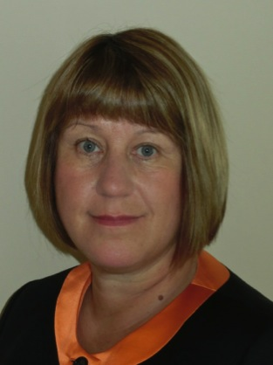
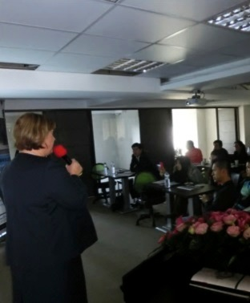
The Director
Julie Harvey BSc(Econ)Hons
International Sales and Marketing Director
Pinnacle MC Global
Director of the holding and all the developing companies
Over 30 years of sales, marketing, property and business experience.
Built up a network of agents worldwide including the UK, Hong Kong, China, Singapore, Indonesia, Thailand
Internationally renowned speaker

Slide 6
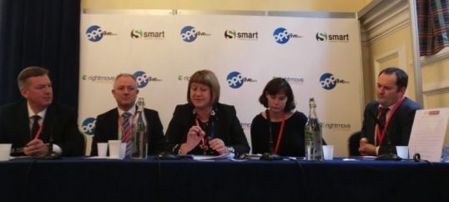
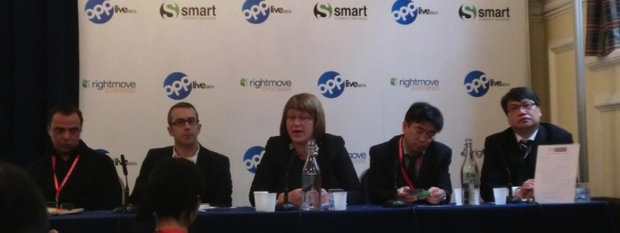
OPP Live 2013
Phillip Hillman
Jones Lang Lasalle
Marcus Roberts
Savills
Julie Harvey
Director Pinnacle
Jo Winchester
C B R E
Knight Frank
Andrew Taylor
CEO Juwai
Lorcan Claffey
CFO Feltrim
Julie Harvey
Director Pinnacle
Adam Wu
CEO China
Business Network
Alan Ma
Partner
Maxwell Alves

Slide 7
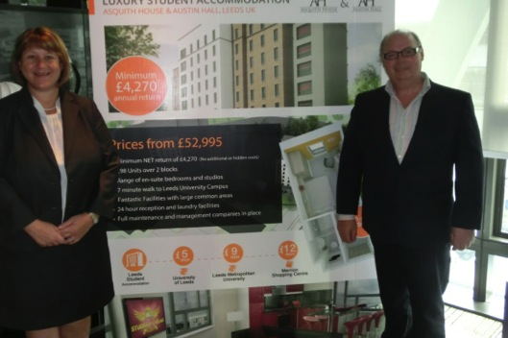
Property Shows Worldwide

Slide 8
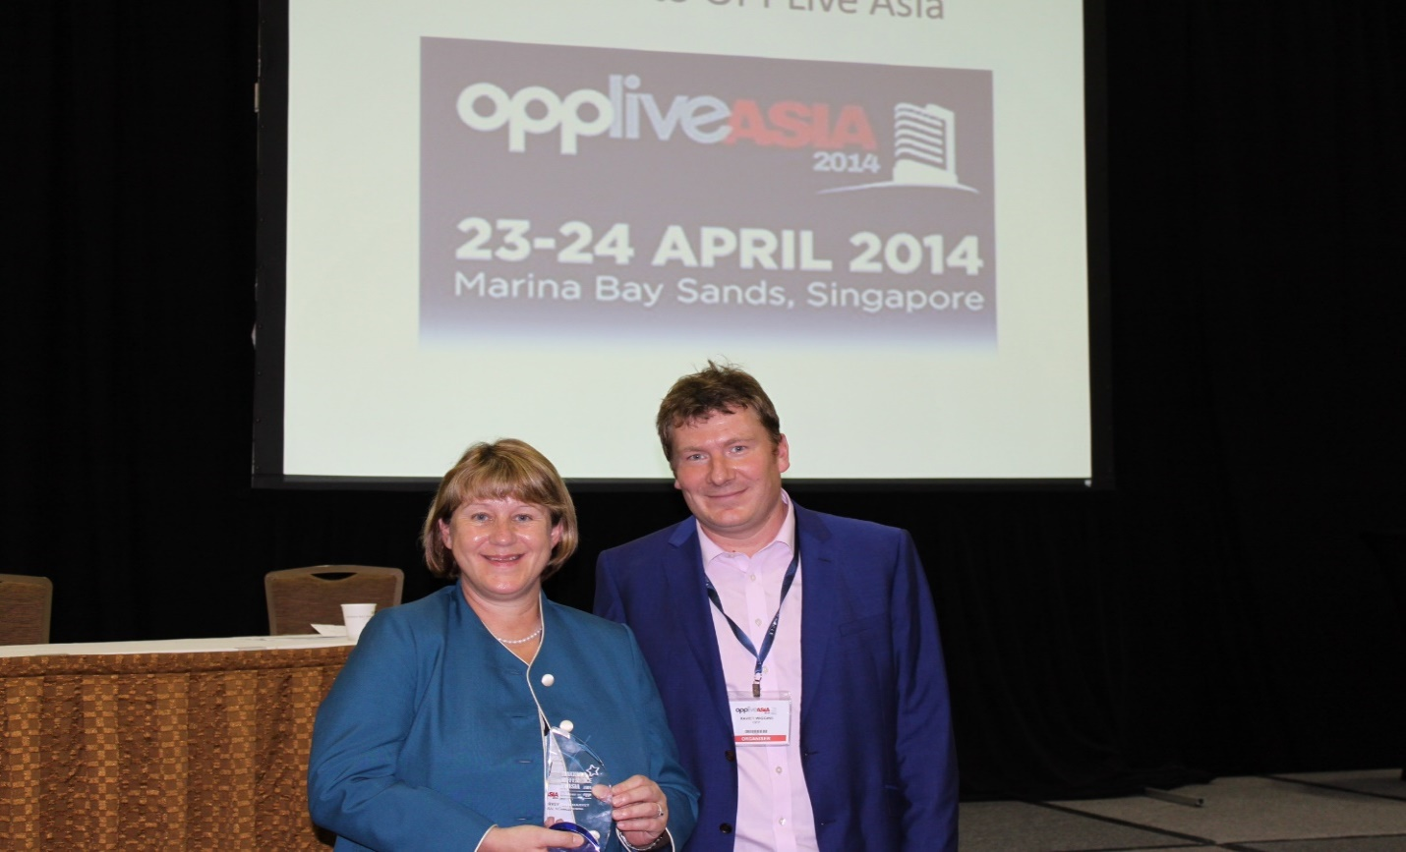
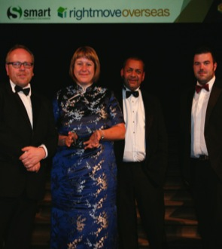
OPP Silver Award Winner 2013
“Best Student Housing Project”
Attractive development
Value for money
Excellent yield
Great company track record
OPP Award Winner 2014
“Making a Difference in Asia”
Awarded to Julie Harvey
Dedication to Asian market
Phenomenal success

Slide 9
The UK
The United
Kingdom
Europe
North
America
Asia
Africa
South
America
Australia

Slide 10
The UK

Slide 11
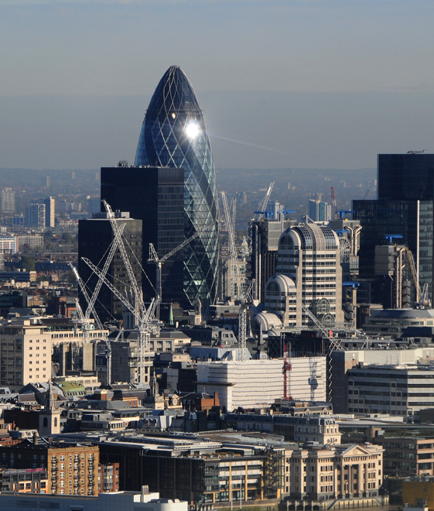
Why Invest
In The UK
Unrivalled Business Environment
Highest levels of legal protection for businesses
Strong economic ties and trade agreements with many commonwealth countries
Highest levels of labour flexibility of all the large EU countries
International Financial Centre
London is the world’s leading international financial centre
Largest investment management industries outside the US.
London is the leading centre for Insurance, Legal and Accountancy

Slide 12
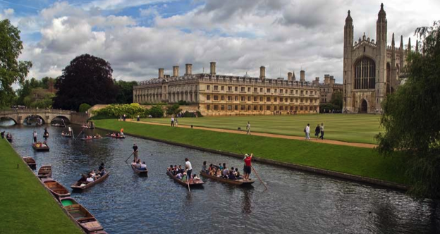
Why Invest
In The UK
Culture and Society
Internationally renowned in the arts and sport
London has become a culinary centre with a wealth of Michelin star restaurants
Strong international reputation for education

Slide 13
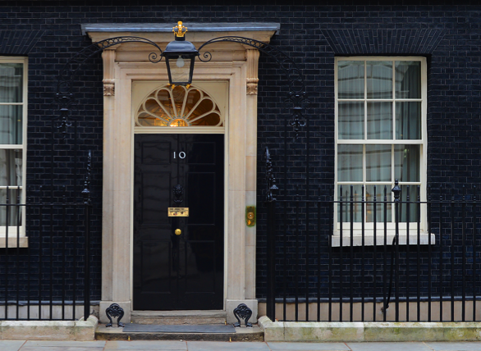
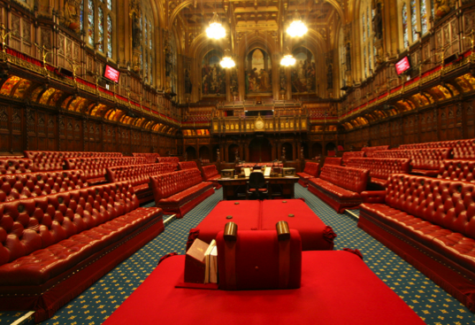
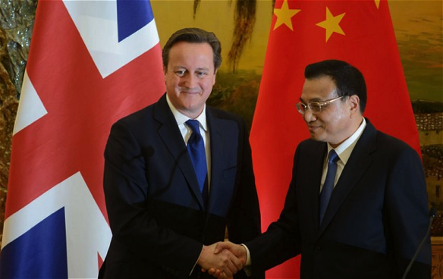
Why Invest
Stability
Highest level of political stability
Strong rule of law – individuals rights and property strongly safeguarded
Safe and secure legal and banking system
In The UK

Slide 14
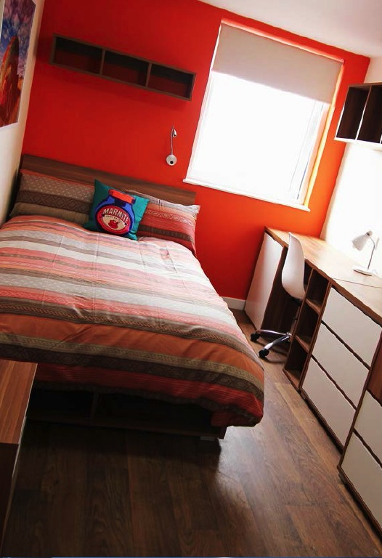
Why Invest
In Student Accommodation?
High Demand – 99% occupancy
Increased income each year as rents increase
2013 saw over £2 billion of investment in the student accommodation sector
Units start from just £57,995
We offer guaranteed minimum yields for 5 years
Average returns in 2012:
8% student
6% residential
5.5% office
2.2% retail
Secure
investment
Low
Entry
level
Assured
Rental
Yields

Slide 15
Why Invest
In Student Accommodation?
UK has a modern open economy and a number of world class universities
14 applicants for every 10 places
International students predicted to increase by 15% - 20% over the next 5 years
University accommodation only available for about 25% students
Severe
under-supply
of high
quality housing
Huge Demand
for high-spec quality accommodation

Slide 16
The UK’s International Student Market
UK is 2nd largest destination for international students after USA
425,265 International students in the UK in 2013/13
Income from international students generated through their tuition fees in 2012-13 came to £3 billion
Degrees from UK universities are prestigious
Advantageous to learn a new language and culture by employers
Number of overseas students studying outside their own country increased from 600k in 1975 to 3.3m in 2008

Slide 17
Why Invest
In Liverpool?
Location: Liverpool, North West England
Population: 466,400
Student Population: 54,565
Vibrant city with four universities
European Capital of Culture 2008
World class tourist destination – 30.5m tourists a year
Fantastic shopping, hotels, museums, galleries, theatres, bars and restaurants
Home to legendary musicians and two of the UK’s biggest football teams
12% of the population are students
London- 2 hours 10 minutes by train,
Manchester- 47 minutes

Slide 18
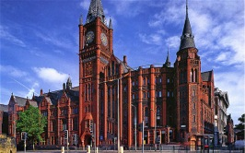
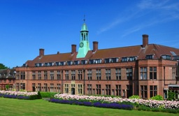
Liverpool Universities
Liverpool John Moores University
One of Britain’s biggest universities - over 18,910 students
Divided into six faculties
Pioneer of multimedia teaching and has one of the UK’s most well-equipped media centres.
9.8% of students are from
overseas
The University of Liverpool
18,295 students from more than 100 countries
Pre-eminent research-based university with over 400 programmes spanning 54 subject Areas
13.4% of students are from overseas
Main campus in the city centre
Liverpool Hope University
5,700 students
2 campus locations. 0.5 miles and
3 miles from city centre.
Attracts students from some 65
countries worldwide
4% of students are from overseas

Slide 19
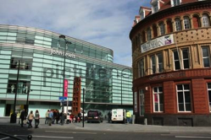
Student Accommodation
In Liverpool
50,000 full time students living in Liverpool
Currently only 9,171 student rooms available
Universities in Liverpool can only supply accommodation for 21 % students
Institution | Total Number of Full Time Students | University Accommodation (bed spaces) | % of bed spaces to F/T Students
University of Liverpool | 18,295 | 4,441 | 24.30%
Liverpool John Moores University | 18,910 | 3,500 | 18.50%
Liverpool Hope University College | 5,700 | 1,230 | 21.60%
The Liverpool Institute for Performing Arts | 705 | 0 | 0.00%
Total | 43,610 | 9,171 | 21.00%

Slide 20
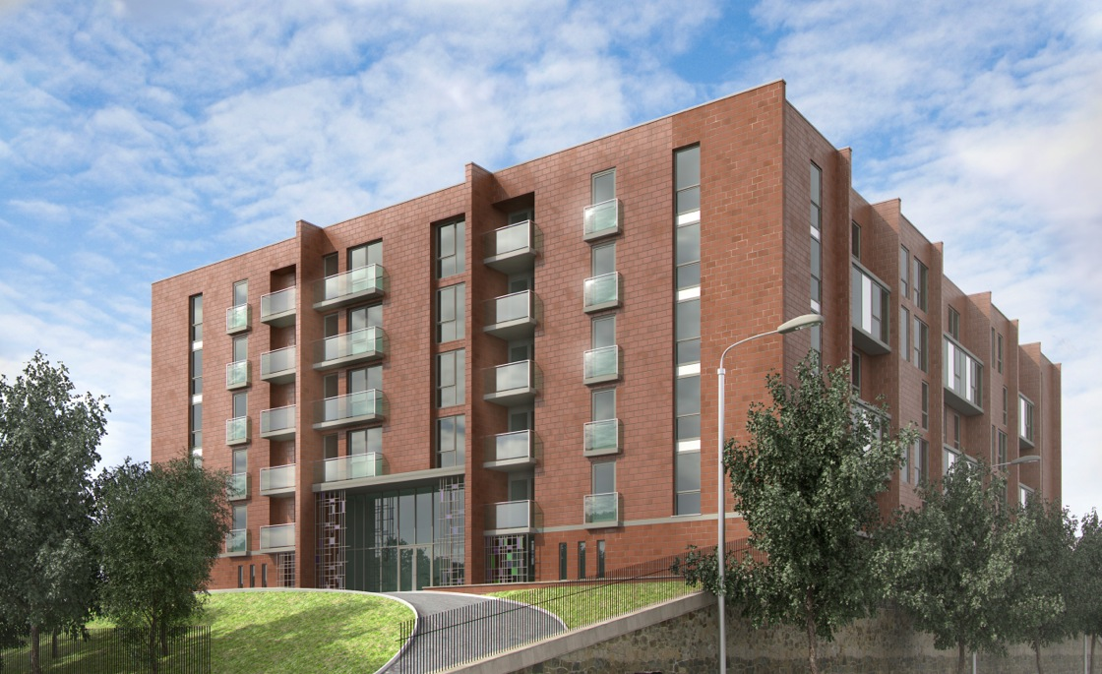
The Quadrant

Slide 21
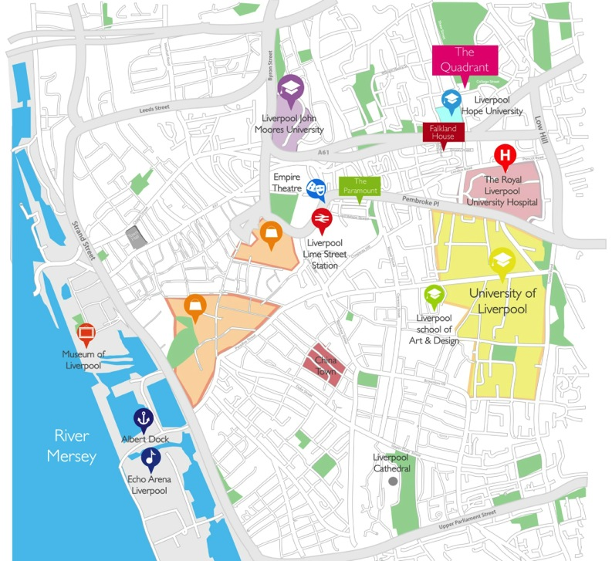
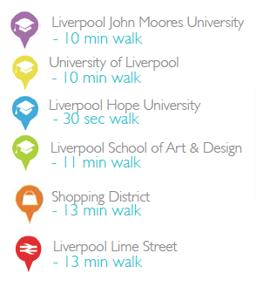
Liverpool
North England, UK

Slide 22
The Opportunity
240 Units over 7 floors
204 En-suite rooms
36 Studio study rooms with kitchenette
Clusters of 8-11 with shared communal
kitchen, dining area and lounge
City centre location
3 universities within 10 minute walk
Annual Income
from
£5,220
External Building

Slide 23
Specifications
En-suite bedroom
Sizes range from 13m2-18.8m2
Arranged in apartments of 8 to 11
Fully Furnished
Small double bed (4ft wide)
Fitted wardrobes
Workstation with study chair
En-suite with shower cubicle, vanity sink unit and toilet
Carpet, blinds, light fittings and personal safe
Internet with hi speed Wi-Fi

Slide 24
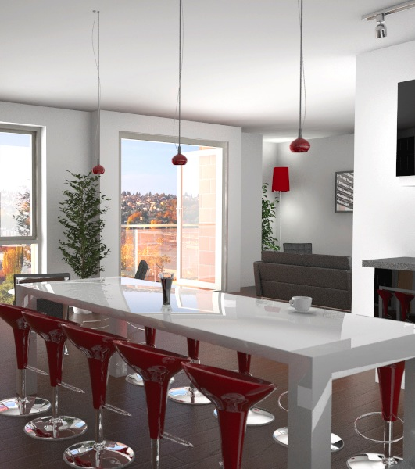
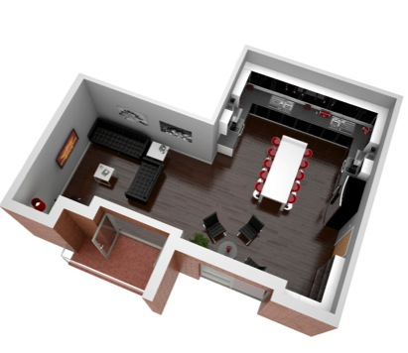
Specifications
Communal Areas
Each apartment shares a communal
area with:
Fully fitted luxury kitchen
Fitted ovens, hobs and extractors
Fridge Freezers
Microwaves
Breakfast bar and seating
Lounge area with sofas and flat screen TV

Slide 25
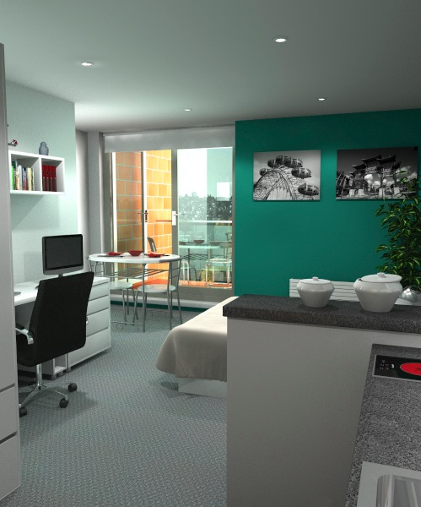
Specifications
Studios
The studios range from 19.9m^{2 –} 25.3m²
Double bed
Fitted wardrobes
Workstation with study chair
Seating Area
Shelving and drawers
Kitchenette with fitted oven, hob and sink
En-suite bathroom with shower cubicle, vanity sink unit and toilet
Carpet, blinds and light fittings
Internet with hi speed Wi-Fi or Ethernet connection

Slide 26
Specifications
Ground Floor
The ground floor gives access to:
Reception with lobby and seating area
Central courtyard and landscaped gardens
Laundry area
Staff offices
Cycle store
Bin store

Slide 27
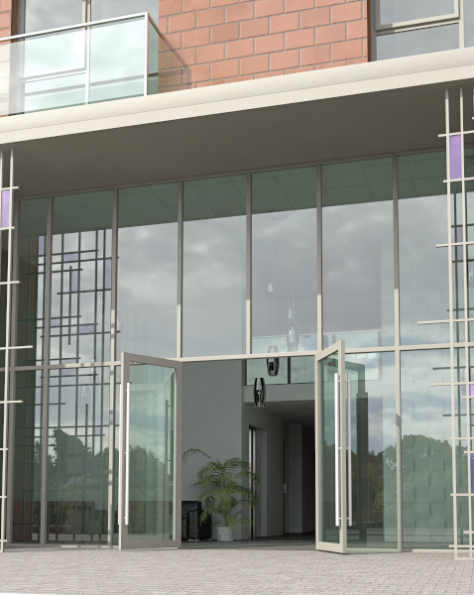
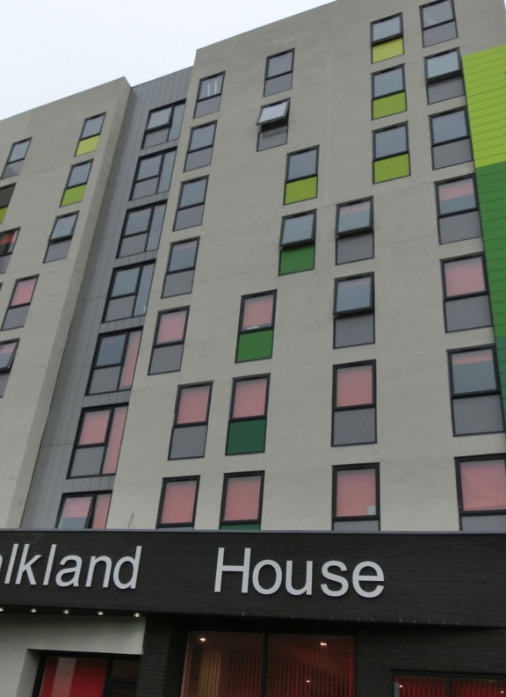
The Contractor
PHD1 Ltd
PHD1 formed in December 2010
Developed over 1,000 properties at a build value of over £125m
Registered as an accredited builder with Checkmate
The Developer
Pinnacle Student Developments
(Liverpool) Ltd
The Development Company is Pinnacle Student Developments (Liverpool) Ltd

Slide 28
The Management
Urban Student Life
www.urbanstudentlife.com
Committed to delivering the next generation of student accommodation
Hi-spec hotel style fixtures and fittings
This covers
Marketing
All utilities – gas/electric water
Insurance
Concierge
Housekeeping
24 hour security and CCTV
Wi-Fi and TV Licences
Sinking fund
Maintenance

Slide 29
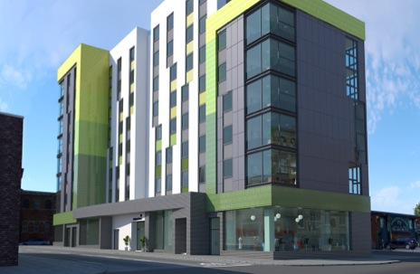
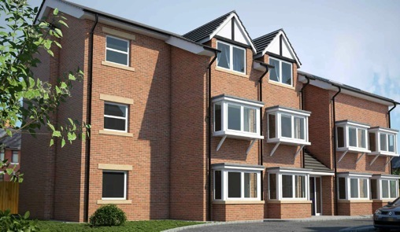
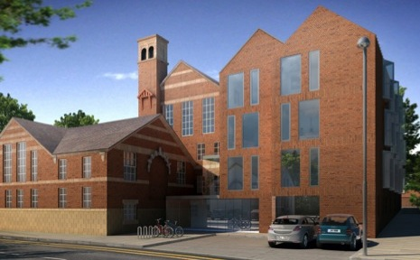
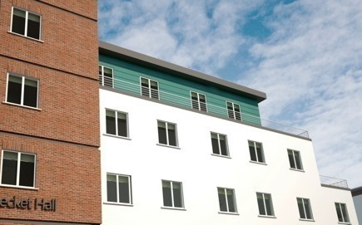
Previous Developments – Over 1000 units sold in 2013!

Slide 30
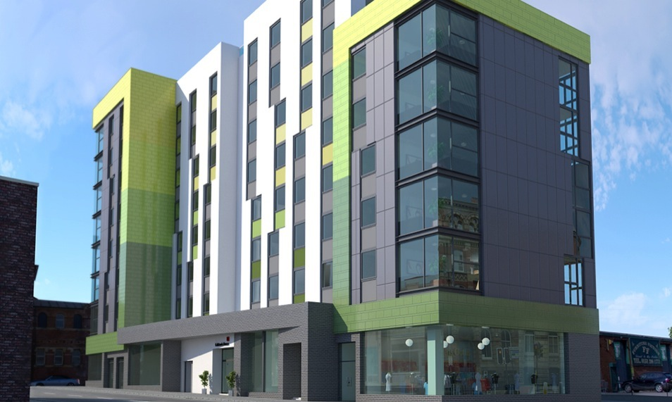
Sold
Out
Falkland House Liverpool

Slide 31
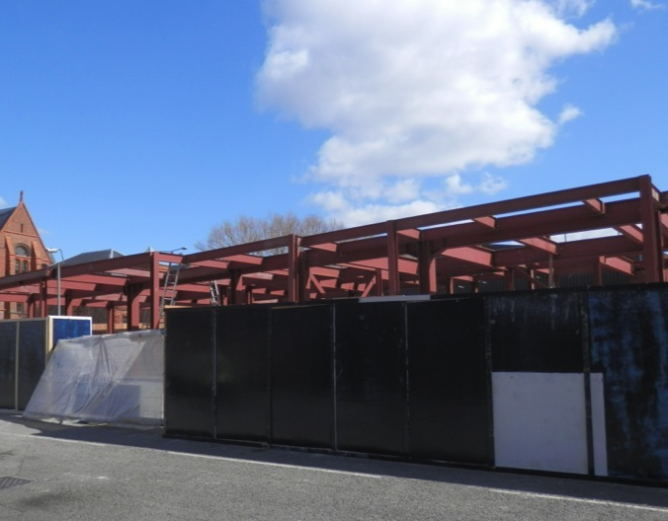
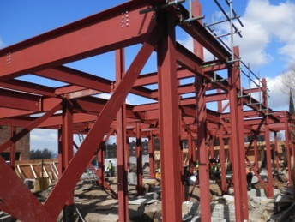
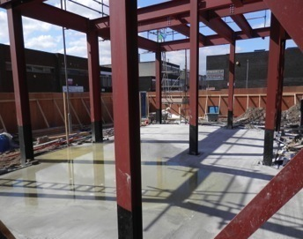
Falkland House Build
Week 4

Slide 32
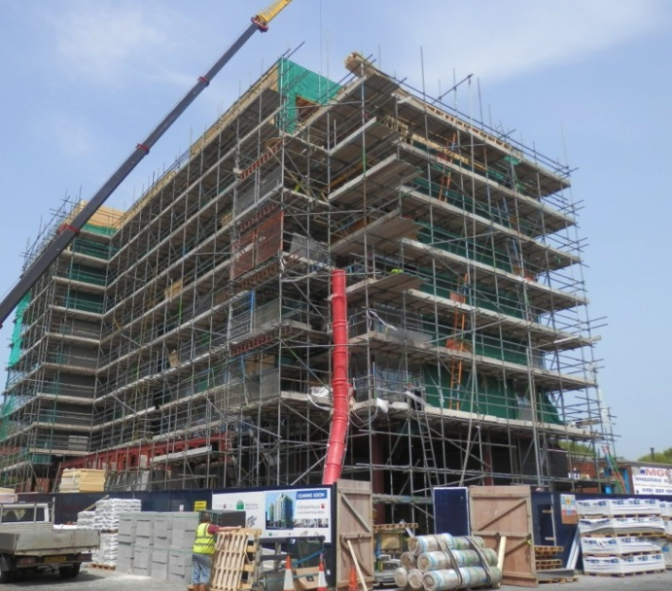
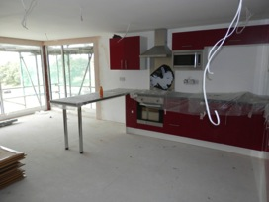
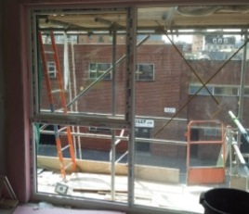
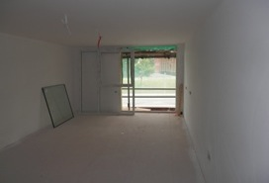
Falkland House Build
Week 16 & 17

Slide 33
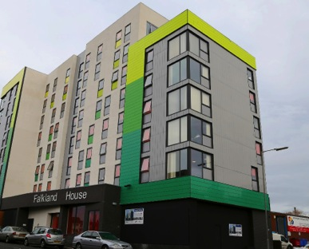
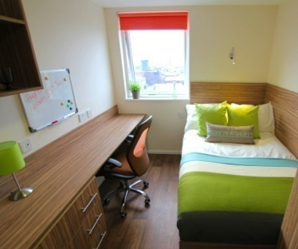
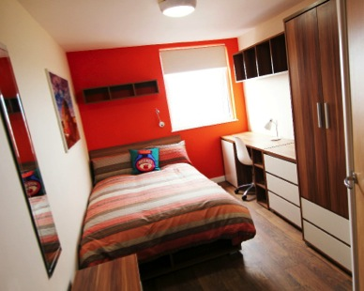
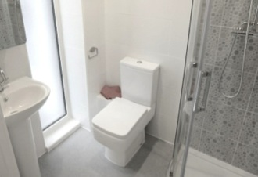
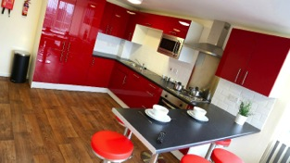
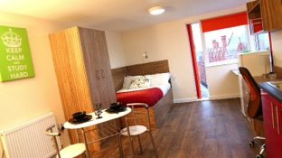
Completed Projects

Slide 34
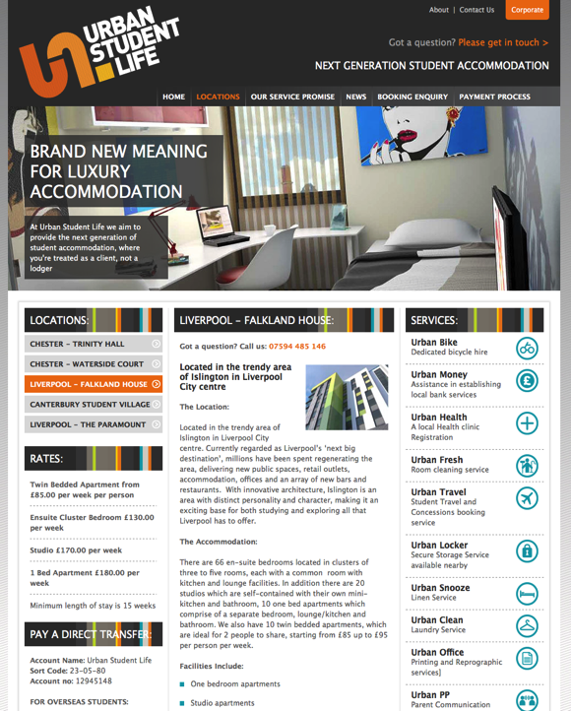
Falkland House
Letting Update
www.urbanstudentlife.com
Bookings taken for September 2014
Investors now receiving income
Income Paid every 3 months

Slide 35
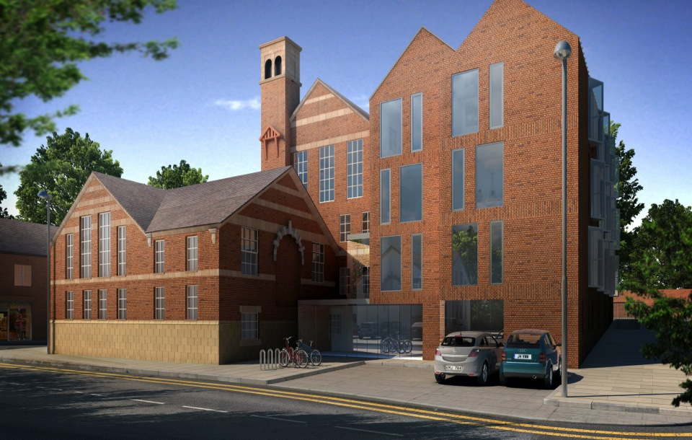
Sold
Out
Trinity Hall, Chester

Slide 36
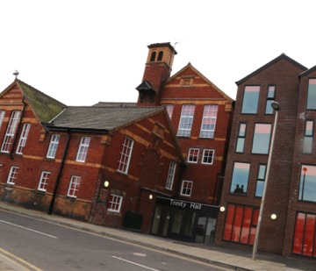
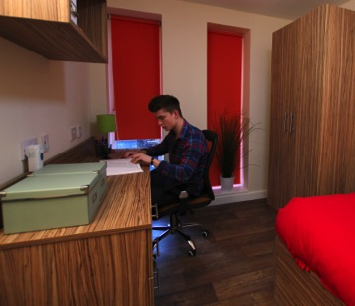
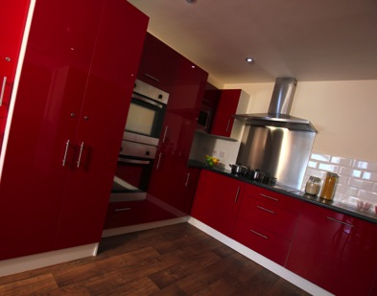
Trinity House Build

Slide 37
Waterside Court, Chester

Slide 38
Waterside Court build

Slide 39
Sold
Out
Construction Started
Canterbury Student Village build

Slide 40
Canterbury Student Village build – Phase 1

Slide 41
Canterbury Student Village build – Phase 2

Slide 42
Units Available
The Paramount build

Slide 43
The Paramount build- Ground works begin

Slide 44
Annual income
from
£5,220
Investment Summary

Slide 45
Exit Strategy
High demand for completed units with a good track record
Sell anytime from completion
Sell to any one, anywhere in the world
Sell direct or via any agency, anywhere in the world.
Legal fees to sell just £700 - £900
Agency fees 2-3 %
Typical completion in 6-8 weeks
Sale price based on yield

Slide 46
Sales Flow Chart
SELECT UNIT
Pay reservation fee £3,000
Exchange contracts
Pay 50% to solicitors secure account
Stage payment 30%
Completion final payment 20%
Receive title deed
Receive first yield payment
3 months later

Slide 47
A Safe and Secure Investment
Proven track record of successful developments
Over 1000 units sold in 2013
All buyers payments held in a secure account
Investors have a charge on the land
Full Title on completion
See website for our latest construction photos:
www.pinnaclemcglobal.com

Slide 48
www.pinnaclemcglobal.com

