Slide 1
Marketing Project Profile Brief
New World Garden @ Plentong, Johor Bahru
A Prestigious Residential Development By:
TAIPAN EAGLE SDN. BHD.(287509-U)

Slide 2
OFFICIAL PROJECT TITLE
A Prestigious Residential Development By:
TAIPAN EAGLE SDN. BHD. (287509-U)
UNIT 1-1A, 1ST FLOOR
SURIAN TOWER
JALAN PJU 7/3, MUTIARA DAMANSARA
47810 PETALING JAYA
SELANGOR DARUL EHSAN
PERSON IN-CHARGE: MR. MICHAEL THAM TEL: 03- 7710 8881 FAX: 03- 7710 7881
CADANGAN PEMBANGUNAN LANDED STRATA YANG MANGANDUNGI:-
92 UNIT RUMAH BERKEMBAR 3 TINGKAT
4 UNIT RUMAH SESEBUAH 3 TINGKAT
1 UNIT RUMAH KELAB 2 TINGKAT
DI ATAS LOT 76349 (PTD 146390), JALAN MASAI BARU, MASAI, MUKIM
PLENTONG, DEARAH JOHOR BAHRU, JOHOR DARUL TAKZIM
UNTUK TETUAN TAIPAN EAGLE SDN. BHD.

Slide 3
General Outlook Of New World Group
Core Modules
36 Stores In China – Self Owned
3 Managed Stores
Covered 18 Major Cities in China
Beijing, Shanghai, Shenyang, Wuhan, Chengdu and several more
Infrastructure - Roads, Energy, Water and Ports & Logistics projects.
Services division comprises Facilities Management , Construction & Transport, Bus and Ferry Services, Strategic Investments and Securities Investments
Hotel Businesses
Telecommunication Businesses

Slide 4
Holding Company
World’s largest jeweler
The jeweler, more than 50% bigger than Tiffany & Co. by revenue and bigger than the jewellery businesses of luxury goods maker Compagnie Financiere Richemont Sa
More than 1,500 outlets and growing
FY2012 HIGHLIGHTS
Same Store Sales Growth of 40.3%
Revenue improved by 61.4% to HK$56.571 billion from HK$35.042 billion of FY2011
Gross profit increased by 65.7% to HK$16.447 billion from HK$9.927 billion of FY2011

Slide 5
Project Location / Information

Slide 6
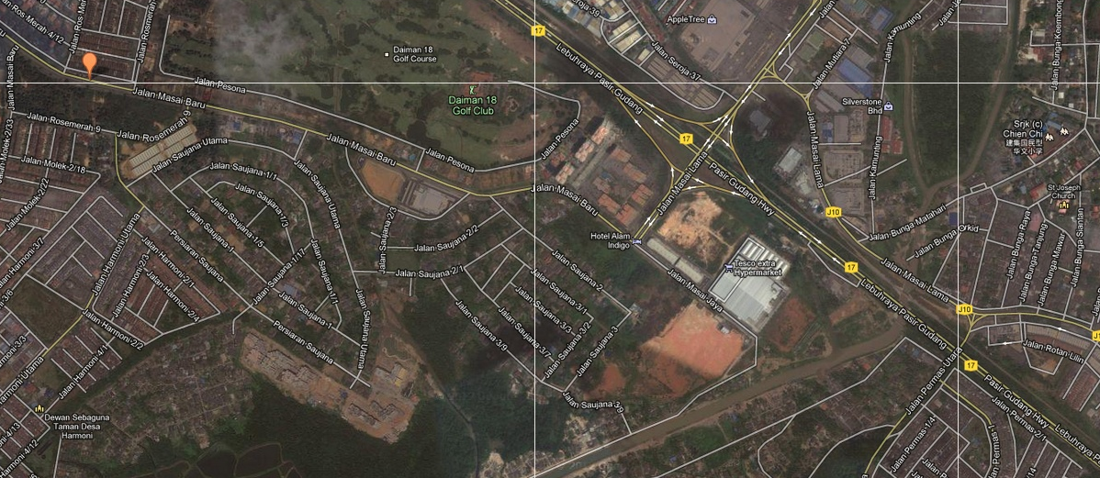
Location Map – Jalan Masai Baru, 81100 Johor Bahru, Johor, Malaysia
New World Development

Slide 7
Nearby Amenities & Hotspots
Nearby Amenities & Hotspots
25minutes to Johor Bahru-Singapore Checkpoint
3minutes to Daiman Golf Club
3minutes to Tesco, Giant, and Carrefour
5minutes to Ponderosa Golf & Country Resort
5Minutes to Taman Molek, Austin Heights Taman Molek is a main township in Johor Bahru, Malaysia. It was developed by Pelangi Berhad Group (formerly owned by Kwok Brothers) in the 1990s and is now a mini commercial hub with several major banks : Standard Chartered, HSBC, Al-Rajhi Bank, Kuwait Finance House, Royal Bank of Scotland, OCBC, UOB, RHB Bank, Maybank, Hwang-DBS Investments, Alliance Bank, Hong Leong Bank.
7minutes to SK Taman Johor Jaya, SRJK (C) Chien Chi
10minutes to Aeon Tebrau City
10Minutes from Medical Facilities such as Johor Jaya Maternity Centre, Hospital Sultan Ismail
15minutes to Foon Yew (C) High School
15minutes from Nusajaya, Iskandar Johor
20Minutes to Danga Bay Danga Bay is set to be a premier waterfront development and one of the highlights of the Iskandar Malaysia, offering amongst others, upscale properties, top-notch retail outlets, thrills and spills of leisure activities, an oasis for local and international food and beverage and top-draw events and activities.

Slide 8
Development Fact Sheet
Project Name New World Garden @ Johor Bahru
Property Composition – 96 units 92 Units of 3-Storey Semi-Detached 4 Units of 3-Storey Bungalow 1 Unit of 2-storey Clubhouse with Swimming Pool
Development Features Gated and Guarded with Armed Security Personnel and intercom system 24/7 CCTV Surveillance (Bosch High Definition Camera HD) Tenure Residential FREEHOLD, LANDED STRATA
Land Area 12.241 Acres
Expected Completion Date Q1 2014
Structural Features With-Stand minor Earthquake With-Stand minor Tropical Storm
Plot Size Bungalow 75’ x 80’ Semi D Villa 40’ x 80’
Size Composition – Built-up 3-Storey Semi-Detached Type A – 4,091 sq.ft. 3-storey Semi-Detached Type B – 4,139 sq.ft. 3-Storey Bungalow – 5,432 sq.ft.
Construction Progress Status Overall site 60% certified completion as on March 2013

Slide 9
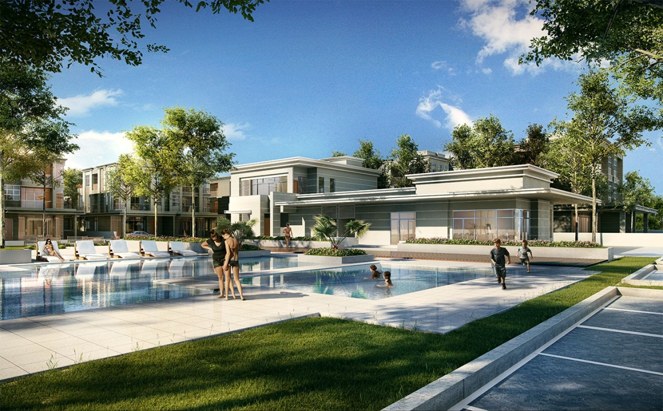
Club House Facilities
2 Multi-purpose halls, gym, swimming pool, kid’s playground with
designer landscaping
Maintenance fees is 0.18sen/sqft (e.g : built-up 4,140 x 0.18)

Slide 10
NWG Entrance
Gated and Guarded with Armed Security Personnel and intercom system
24/7 CCTV Surveillance (Bosch High Definition Camera HD)

